Slide 1

UNIT 2B
WHAT DO YOU BUILD?
(QUESTION MODEL 1.2)

Slide 2





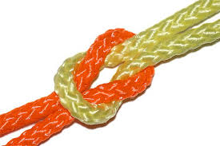

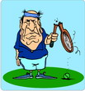


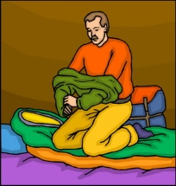








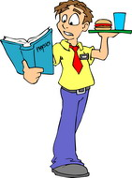
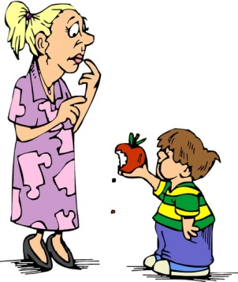

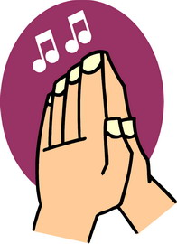



VOCABULARY – TRANSITIVE VERBS
TO BUILD | TO LOCK | TO TURN ON | TO SMOKE | TO TIE
TO BURN | TO UNLOCK | TO TURN OFF | TO BREAK | TO TAKE OFF
TO CHASE | TO PULL | TO SERVE | TO HIT | TO PUT ON
TO CATCH | TO PUSH | TO REVIEW | TO BEAT | TO BITE
TO SHOOT | TO SIGN | TO STOP | TO KICK | TO CLAP

Slide 3
VOCABULARY - PICTURES

Slide 4
VOCABULARY - LISTENING

Slide 5
MODEL FORMING
QUESTION MODEL 1.2
WHAT DO YOU BUILD?
I BUILD HOUSES.

Slide 6
QUICK REACTION PRACTICE
build | houses, bridges
lock | the door, the window
turn on | the radio, the TV
smoke | a cigar, a cigarette
tie | a bag, a box
burn | the chair, the shelf
unlock | the gate, the suitcase
turn off | the light, the fan
break | a plate, a glass
take off | my slippers, my shoes
chase | a dog, a mouse
pull | the chair, the desk
serve | coffee, tea
hit | the ceiling, the wall
put on | a hat, a scarf
catch | a bus, a taxi
push | the sofa, the table
review | the lessons, my homework
beat | an egg, the drum
bite | an apple, a potato
shoot | the bird, the goose
sign | a letter, a contract
stop | the music, the game
kick | the ball, the rock

Slide 7
HOMEWORK
Write 20 questions and answers using Question Model 1.2

